Slide 1



Anxiety & Depression Group
Prediction Using Machine Learning

Slide 2
Problem Statement and Dataset Overview
Objective:
Classify anxiety & depression trends into early
vs.
late response groups based on survey data.
Dataset Source:
U.S. CDC Household Pulse Survey
Key Features:
• Subgroup: demographic
category:
• Value: % reporting
symptoms:
• Time Period: survey week
(1–52)
• Group_Label: Binary target
(0 = early, 1 = late)

Slide 3

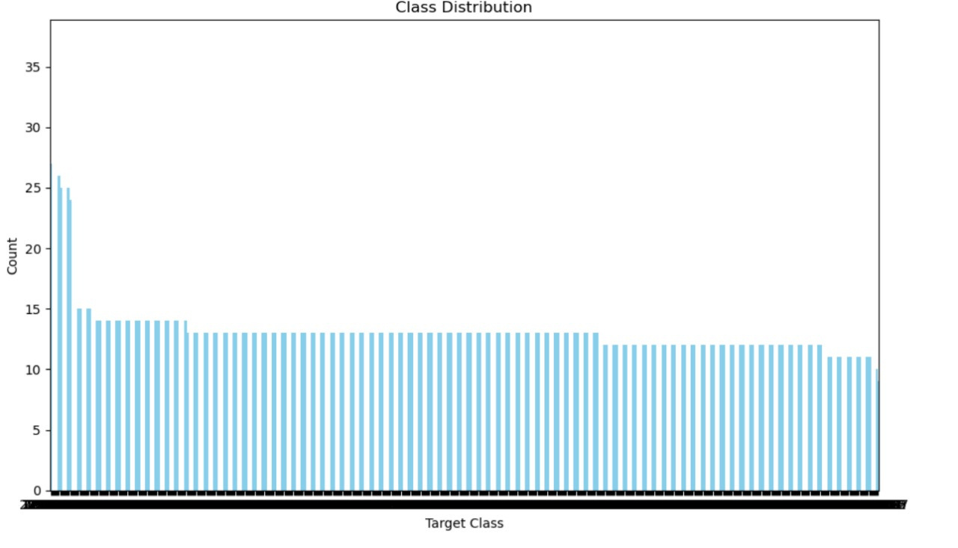
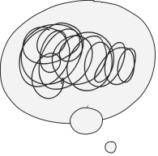


Target Variable Construction -Class Distribution

Slide 4

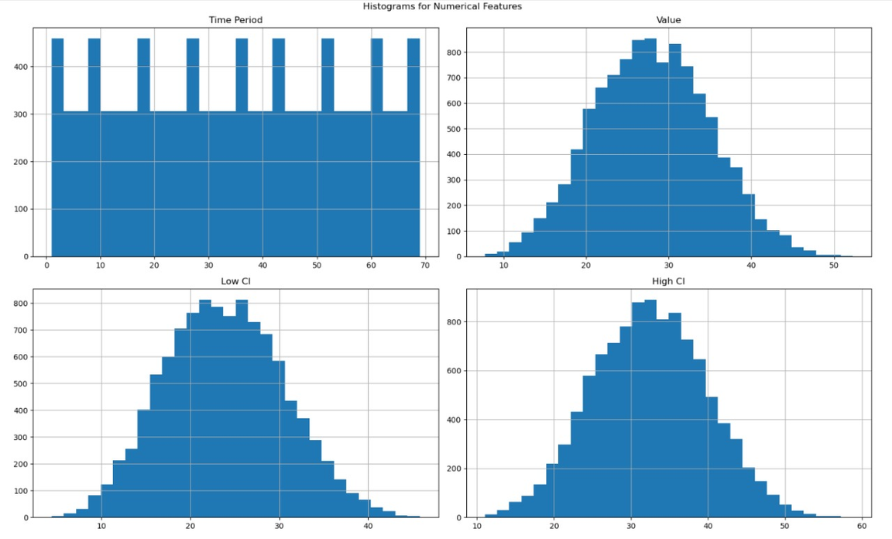
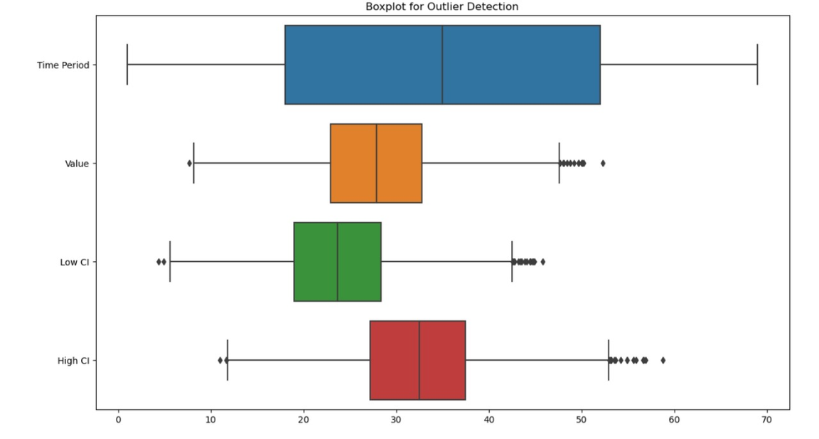
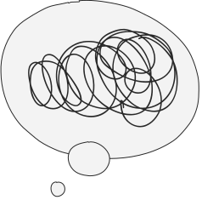






Data Preprocessing - Distribution and Outliers

Slide 5

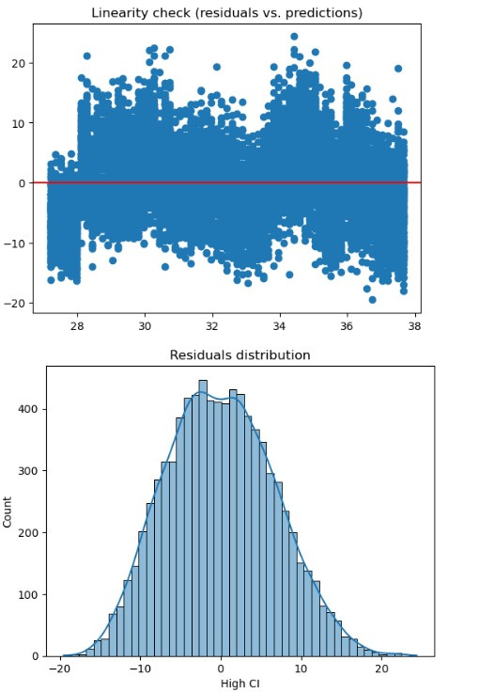
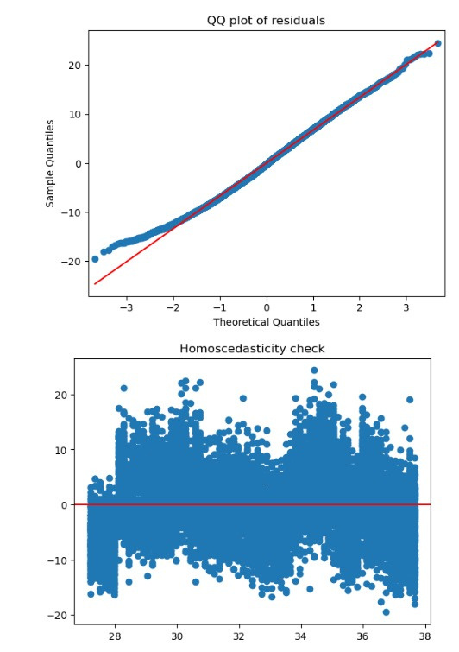



Linear Regression assumption checks

Slide 6

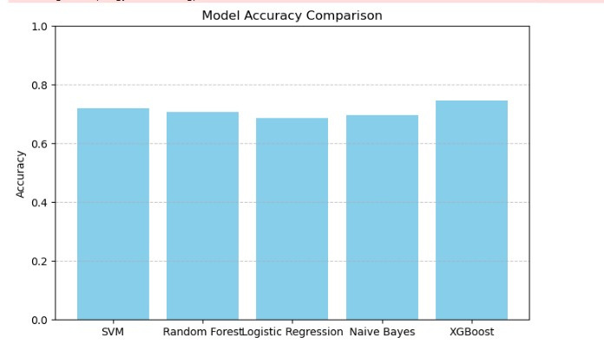


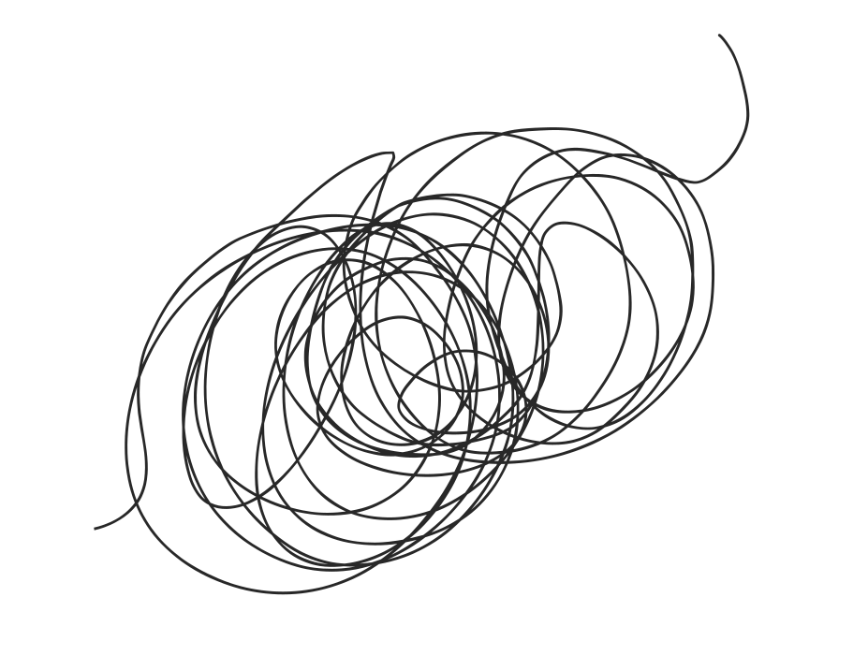
Model Training and Comparison

Slide 7

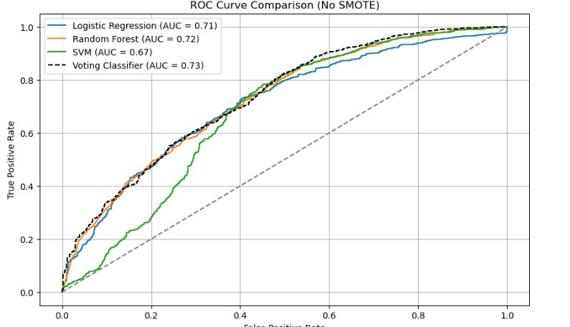

Best model selection (ROC Curve)

Slide 8
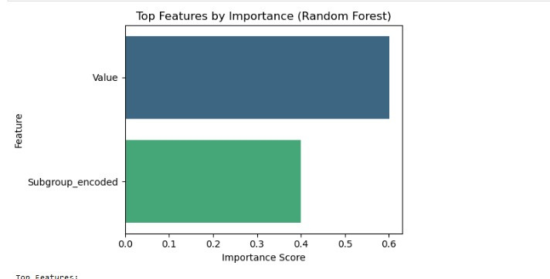
Feature Importance

Slide 9
Conclusion

Slide 10
Streamlit Web Application

Slide 11
Thanks!

